Slide 1

Unemployment and Inflation
How unemployment is measured and how the unemployment rate is calculated
Types of unemployment
The significance of the unemployment rate for the economy
The factors that determine the natural rate of unemployment
To First
Active Learning
To Video

Slide 2
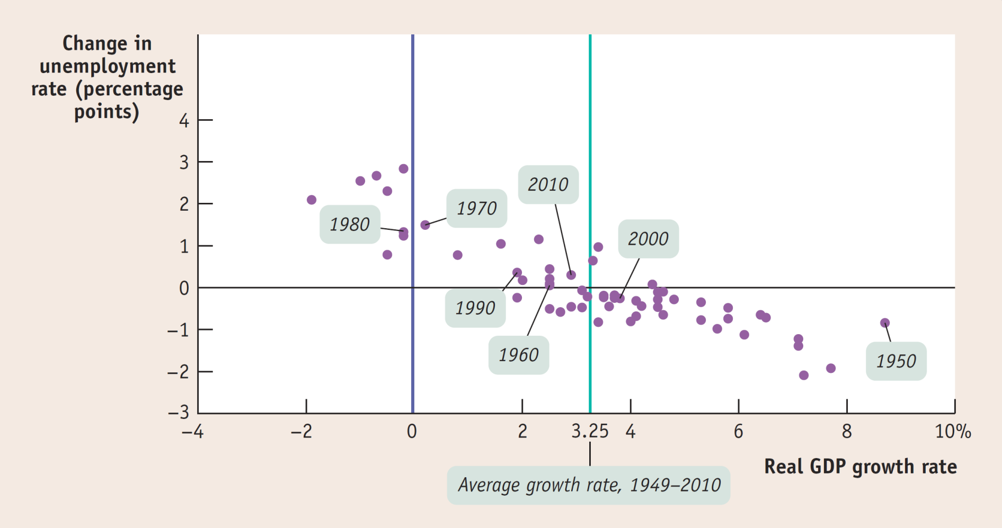
Growth and Changes in Unemployment, 1949–2010
Generally there is a strong negative relationship between growth in the economy and the rate of unemployment.
Average 3.25% of GDP growth == 0% change in unemployment
Sources: Bureau of Labor Statistics; Bureau of Economic Analysis.

Slide 3
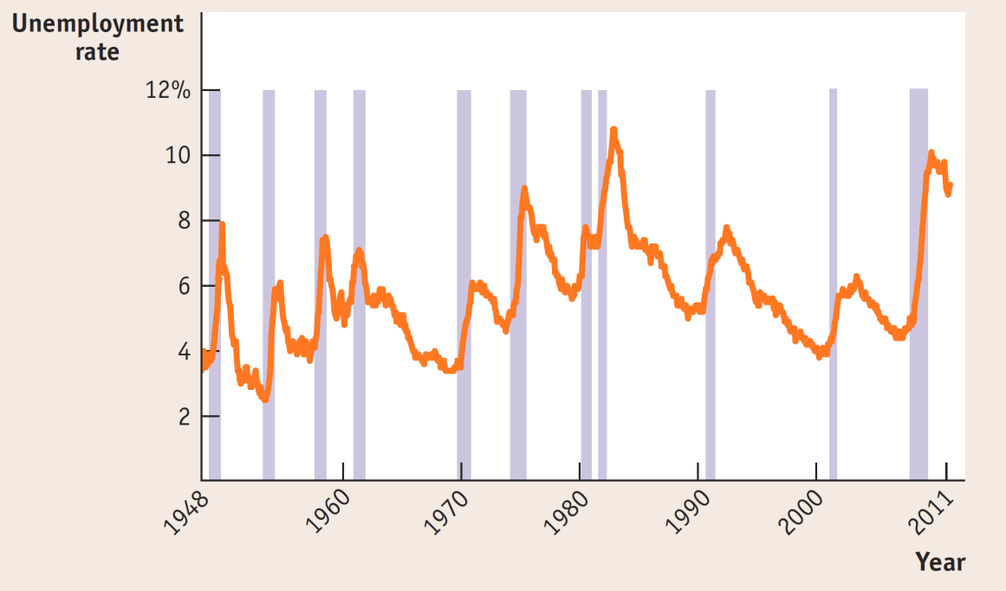
The U.S. Unemployment Rate, 1948–2011
Unemployment always rises during recessions and
usually falls during periods of economic expansion.
Sources: Bureau of Labor Statistics; National Bureau of Economic Research.

Slide 4
The Significance of the Unemployment Rate
The unemployment rate is a good indicator of how easy or difficult it is to find a job given the current state of the economy.
It can overstate the true level of unemployment.
Even if the labor market is healthy, it takes time to find the right job.
It can understate the true level of unemployment.
You are not “unemployed” if you have given up looking for a job because there are no jobs available, or being employed as a part-time worker.
Marginally-attached workers
Under-employment
Discouraged workers

Slide 5
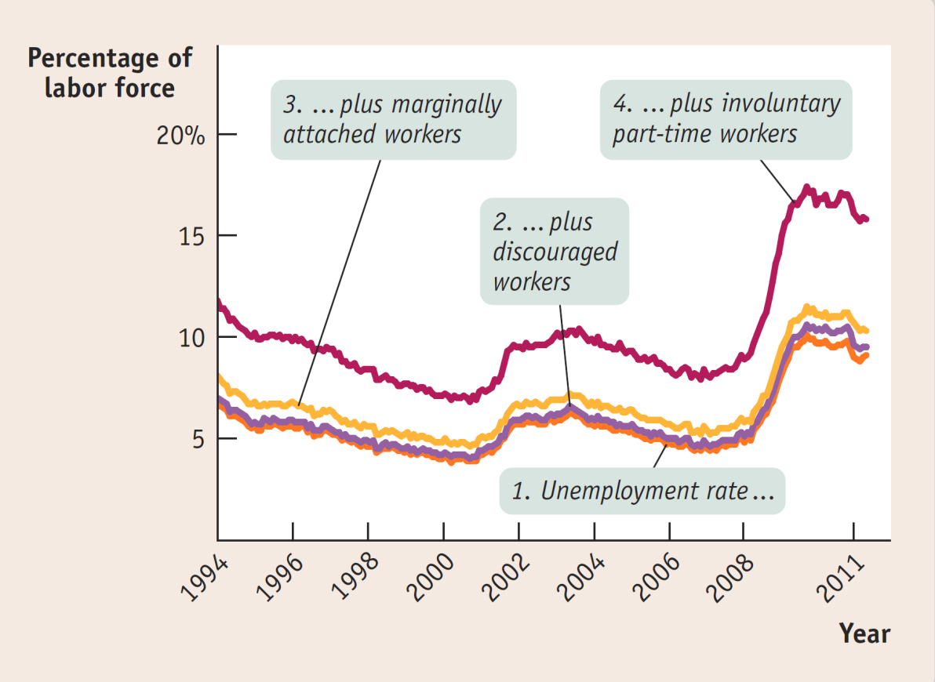
Alternative Measures of Unemployment, 1994–2011
Source: Bureau of Labor Statistics

Slide 6
Defining Unemployment
Measuring the labor force participation rate (LFPR):
-The percent of the adult (16+) non-institutionalized civilian population who are working or actively looking for work.
-(Labor force / Adult Population) x 100%
-Adult Population: age 16 or older
-Labor force: not included military, seniors, retirees, disabled, discouraged workers
Measuring unemployment
The unemployment rate is the percent of the labor force without a job:
-( Unemployed / Labor Force ) x 100%
-Unemployed is defined as: those who are looking for jobs, and available for work.

Slide 7
Adult population | 200 million
Labor force | 150 million
Employed persons | 138.75 million
Discouraged workers | 10.5 million
According to the table, the unemployment rate is _________ and the labor force participation rate is __________.
7%; 60.4%
0.7%; 99.3%
5.6%; 69.4%
7.5%; 75%
To Next
Active Learning

Slide 8
Which of the following individuals can be counted as unemployed?
Darren, a 10-year-old child
Nazma, a stay-at-home mom
Moesha, a full-time college student
Carl, who works part time at the Olive Garden but would prefer more hours
None of the answers is correct.
To Next
Active Learning

Slide 9
The Natural Rate of Unemployment
Some unemployment is natural.
Over the past 50 years, the national unemployment rate has never dropped below 2.9%.
There are three types of unemployment:
frictional
structural
Cyclical
(Also, Seasonal Unemployment)
Natural Unemployment: frictional + structural
Cyclical unemployment: unemployment correlated with the business cycle in the economy —the deviation from the natural rate. During recession, cyclical unemployment emerges. The “99-ers” following the 2008 housing crisis.

Slide 10






Frictional Unemployment
Frictional unemployment: due to the time spend in job search.
-Scarcity of information creates frictional unemployment.
-Matching people to jobs takes time.

Slide 11

Structural Unemployment
Structural unemployment: due to changes in the structure of the labor market or in some industries.
Some causes:
Labor unions
Labor unions sometimes increase wages above the equilibrium.
Efficiency wages
Efficiency wages: wages that is above the equilibrium rate as an incentive for better employee performance.
Side effects of government policies
minimum wage law
Mismatches between employees and employers
Geography or skills or industries or stages of economic development

Slide 12
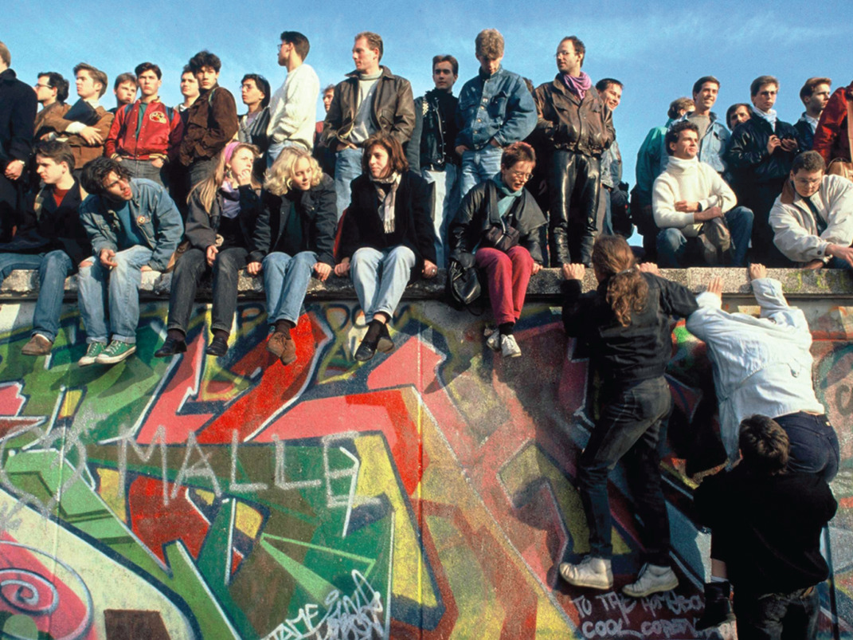
Structural Unemployment in East Germany
Since reunification in 1989, East Germany’s economy has remained depressed, with productivity low and structural unemployment high.

Slide 13
Structural Unemployment
Effect of minimum wage on low-skilled unemployment
Wage rate
Structural
unemployment
Labor supply
Minimum
wage
Minimum
wage
Equilibrium
wage
Labor demand
Q_{D}
Q_{E}
Q_{S}
Quantity of labor
(lookup: http://www.dol.gov/whd/minwage/america.htm)

Slide 14
Which of the following statements is true?
The natural rate of unemployment equals a country’s unemployment rate during a recession.
The natural rate of unemployment equals a country’s unemployment rate during an expansion.
The natural rate of unemployment is the sum of frictional and structural unemployment.
The natural rate of unemployment is the sum of frictional and cyclical unemployment.
To Next
Active Learning

